Slide 1
Context-Free Languages (CFL)
CSC3113: Theory of Computation
6
6
Spring 2023-2024
Sharfuddin Mahmood, Assistant Professor,
Department of Computer Science, Faculty of Science & Technology.
smahmood@aiub.edu

Slide 2
Formal Definition of CFL
Context Free Grammar (CFG)
Designing CFG
Ambiguity
Chomsky Normal Form (CNF)

Slide 3
Concept and Definition of Context Free Language (CFL)
Concept and Construct of Context Free Grammar (CFG)
Designing CFG

Slide 4
All outcome are represented with examples
Learn the concept and Formal Definition of CFL
Understand the construct of CFG
Learn and Design CFG for languages
Understand and practice the construct of CFG
Learn ambiguity in grammar and ways to identify and remove it.
Apply Chomsky Normal From (CNF) on grammar to make it computable.

Slide 5
Context-Free Languages
Context-Free Languages includes all regular languages and many additional languages, such as {0^{n}#1^{n} | n ≥ 0}.
Additional memory is used to recognize such languages.
Context-Free Grammars.
More powerful method of describing language.
Can describe certain features that have a recursive structure.

Slide 6
Example: Context-Free Grammars
A → 0A1 A → 0A1 | B
A → B or B → #
B → #
A grammar consists of a collection of Substitution (or Production) rules.
Each rule appears as a line in the grammar.
Each line has a variable and a string separated by an arrow.
Variable consists of a symbol.
represented as uppercase letters.
might include index or subscript.
Strings consists of variables and/or other symbols called terminals.
terminals are analogous to input alphabet, represented as lowercase letters, numbers, or special symbols.
might include index or subscript.
One variable is designated the start variable, usually the left-hand side of the topmost rule.
Several rules for the same left-hand variable can be written using “|” as an “or”.

Slide 7
Context-Free Grammars
Use a grammar to describe a language by generating each string of the language in the following manner –
Write down the start variable, s.
Choose a variable v from the right-hand side of the rule for s.
Find a rule that starts with (or left-hand side is) v.
Replace v in rule s by right-hand side of rule v.
Repeat from step 2 to 4 until no more variables remains.
The sequence of substitutions to obtain a string is called derivation. Derivation of string 000#111 in the grammar –
A → 0A1 | B B → #
A⇒ 0A1⇒ 00A11⇒ 000A111⇒ 000B111⇒ 000#111
Using Parse Tree: Figure on the right
A
A
A
A
B
0
0
0
#
1
1
1

Slide 8
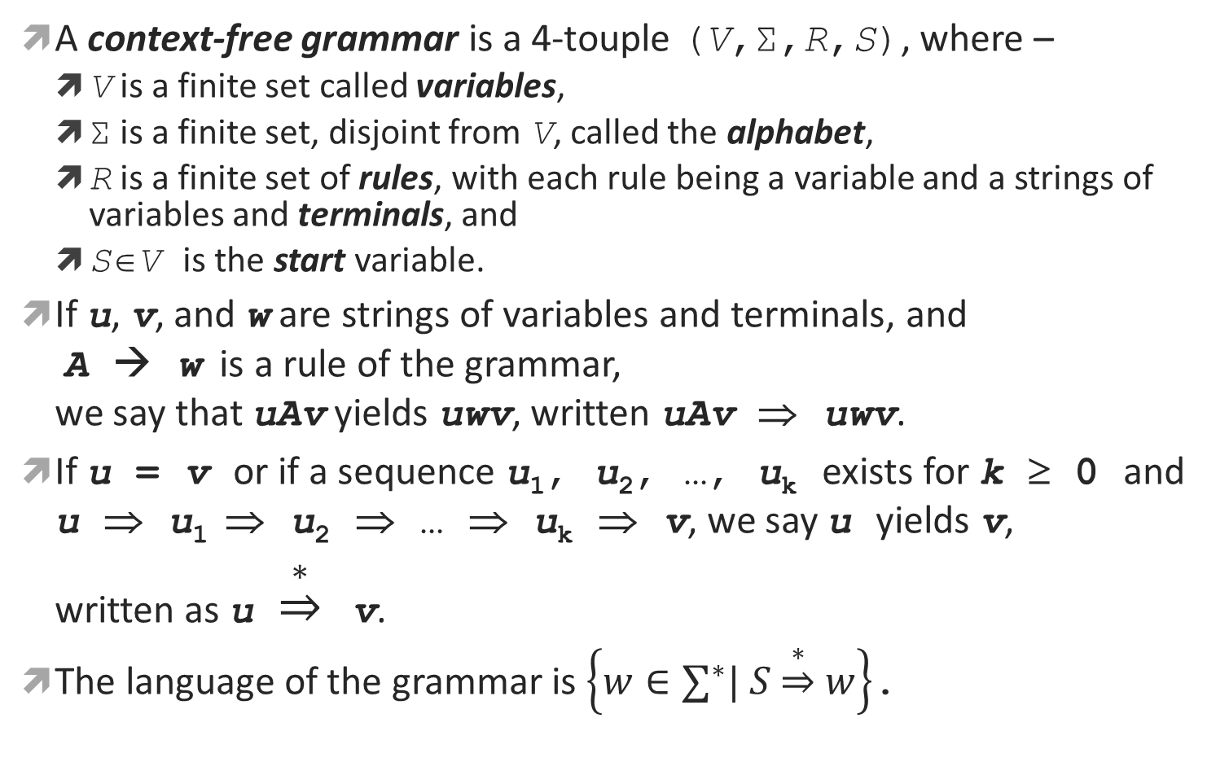
Formal Definition
A context-free grammar is a 4-touple (V,Σ,R,S), where –
V is a finite set called variables,
Σ is a finite set, disjoint from V, called the alphabet,
R is a finite set of rules, with each rule being a variable and a strings of variables and terminals, and
S∈V is the start variable.
If u, v, and w are strings of variables and terminals, and A → w is a rule of the grammar, we say that uAv yields uwv, written uAv ⇒ uwv.
If u = v or if a sequence u₁, u₂, …, u_{k} exists for k ≥ 0 and u ⇒ u₁ ⇒ u₂ ⇒ … ⇒ u_{k} ⇒ v, we say u yields v, written as u $\underset{⇒}{∗}$ v.
The language of the grammar is $\left\{w∈∑^{∗}| S\underset{⇒}{∗}w\right\}$.

Slide 9
Designing CFG
A={ w | w begins with a and ends with b } | S → aTb T → aT | bT | ∈
A={ w | w begins with b or ends with a } | S → bT | Ta T → aT | bT | ∈
A={ w | w contains at least 3 a‘s } | S → TaTaTaP T → bT | ∈ P → aP | bP | ∈
A={ w | w contains at most 3 a‘s } | S → BABABAB A → a | ∈ B → bB | ∈
A={ w | w contains the substring aba } | S → TabaT T → aT | bT | ∈
A={ w | w does not contain the substring aba } | S → bS | aT | ∈ T → aT | bR | ∈ R → bS | ∈
A={ w | every odd position of w is a } | S → aT | ∈ T → aS | bS | ∈
A={ w | w = a^{m}b^{n} and m = n} | T → aTb | ∈

Slide 10
Ambiguity – Parse Tree
If a grammar generates the same string in several different ways, we say that the string is derived ambiguously in the grammar.
If a grammar generates some string ambiguously we say that the grammar is ambiguous.
Example: Grammar G, ⟨EXPR⟩→⟨EXPR⟩+⟨EXPR⟩|⟨EXPR⟩×⟨EXPR⟩|(⟨EXPR⟩)|a
Two parse trees for the string a+a×a in G
⟨EXPR⟩
⟨EXPR⟩
⟨EXPR⟩
⟨EXPR⟩
⟨EXPR⟩
⟨EXPR⟩
⟨EXPR⟩
⟨EXPR⟩
⟨EXPR⟩
⟨EXPR⟩
a
+
a
×
a
a
+
a
×
a

Slide 11
Chomsky Normal Form
It is often convenient to have CFGs in simplified form. One such form is Chomsky normal form.
A context free grammar is in Chomsky normal form if every rule is of the form A → BC A → a where a is any terminal and A, B, and C are any variables – except that B and C may not be the start variable. In addition S → ε is permitted, where S is the start variable.

Slide 12
Example: Converting to CNF
Conversion Steps:
Add a new start variable (substitute by old start variable).
Remove all epsilon rules, V₁ → ε.
Look for V₁ on right side of the arrow of all the rules.
Replace these V₁ by ε in all possible way, whatever string comes as a result, add them to the same rule using OR “|”.
Remove all unit rules, V₁ → V₂.
Look for the rule R for V₂.
Replace the V₂ of the unit rule by right side of the arrow of R.
Convert all rules to CNF rule format, V₁ → V₂V₃, V₁ → t.
Introduce new rules with new variables to convert the existing non-CNF rules to CNF rules.
Try to have these new rules in the CNF format.
CNF: Rules Format
A variable substitute by two variables V₁ → V₂V₃
A variable substitute by a single terminal V₁ → t
Exception: the start variable may have an epsilon rule S₀ → ε
Original Grammar
S → ASA | aB
A → B | S
B → b | ε
CNF Conversion:
S₀ → S
S → ASA | aB
A → B | S
B → b | ε
S₀ → S
S → ASA | aB | a
A → B | S | ε
B → b | ε
S₀ → S
S → ASA | aB | a
A → B | S | ε
B → b
S₀ → S
S → ASA | aB
A → B | S
B → b | ε
S₀ → S
S → ASA | aB | a
A → B | S | ε
B → b
S₀ → S
S → ASA | aB | a | SA
A → B | S | ε
B → b
S₀ → S
S → ASA | aB | a | SA | AS
A → B | S | ε
B → b
S₀ → S
S → ASA | aB | a | SA | AS | S
A → B | S | ε
B → b
S₀ → S
S → ASA | aB | a | SA | AS | S
A → B | S
B → b
S₀ → S
S → ASA | aB
A → B | S
B → b | ε
Step 1:
Adding new start variable S₀.
Step 2:
\
Remove B → ε
\
Remove A → ε

Slide 13
Example: Converting to CNF
Conversion Steps:
Add a new start variable (substitute by old start variable).
Remove all epsilon rules, V₁ → ε.
Look for V₁ on right side of the arrow of all the rules.
Replace these V₁ by ε in all possible way, whatever string comes as a result, add them to the same rule using OR “|”.
Remove all unit rules, V₁ → V₂.
Look for the rule R for V₂.
Replace the V₂ of the unit rule by right side of the arrow of R.
Convert all rules to CNF rule format, V₁ → V₂V₃, V₁ → t.
Introduce new rules with new variables to convert the existing non-CNF rules to CNF rules.
Try to have these new rules in the CNF format.
CNF: Rules Format
A variable substitute by two variables V₁ → V₂V₃
A variable substitute by a single terminal V₁ → t
Exception: the start variable may have an epsilon rule S₀ → ε
Original Grammar
S → ASA | aB
A → B | S
B → b | ε
CNF Conversion:
S₀ → S
S → ASA | aB | a | SA | AS | S
A → B | S
B → b
S₀ → S
S → ASA | aB | a | SA | AS
A → B | S
B → b
S₀ → S
S → ASA | aB | a | SA | AS
A → B | S
B → b
S₀ → ASA | aB | a | SA | AS
S → ASA | aB | a | SA | AS
A → B | S
B → b
S₀ → ASA | aB | a | SA | AS
S → ASA | aB | a | SA | AS
A → B | S
B → b
S₀ → ASA | aB | a | SA | AS
S → ASA | aB | a | SA | AS
A → b | S
B → b
S₀ → ASA | aB | a | SA | AS
S → ASA | aB | a | SA | AS
A → b | S
B → b
S₀ → ASA | aB | a | SA | AS
S → ASA | aB | a | SA | AS
A → b | ASA | aB | a | SA | AS
B → b
S₀ → ASA | aB | a | SA | AS
S → ASA | aB | a | SA | AS
A → b | ASA | aB | a | SA | AS
B → b
S₀ → S
S → ASA | aB | a | SA | AS | S
A → B | S
B → b
S₀ → S
S → ASA | aB | a | SA | AS
A → B | S
B → b
S₀ → ASA | aB | a | SA | AS
S → ASA | aB | a | SA | AS
A → B | S
B → b
S₀ → ASA | aB | a | SA | AS
S → ASA | aB | a | SA | AS
A → b | S
B → b
Step 3:
Remove S → S
Remove S₀ → S
Remove A → B
Remove A → S

Slide 14
Example: Converting to CNF
Conversion Steps:
Add a new start variable (substitute by old start variable).
Remove all epsilon rules of the form, V₁ → ε.
Look for V₁ on right side of the arrow of all the rules.
Replace these V₁ by ε in all possible way, whatever string comes as a result, add them to the same rule using OR “|”.
Remove all unit rules of the form, V₁ → V₂.
Look for the rule R for V₂.
Replace the V₂ of the unit rule by right side of the arrow of R.
Convert all rules to CNF rule format, V₁ → V₂V₃, V₁ → t.
Introduce new rules with new variables to convert the existing non-CNF rules to CNF rules.
Try to have these new rules in the CNF format.
CNF: Rules Format
A variable substitute by two variables V₁ → V₂V₃
A variable substitute by a single terminal V₁ → t
Exception: the start variable may have an epsilon rule S₀ → ε
Original Grammar
S → ASA | aB
A → B | S
B → b | ε
CNF Conversion:
S₀ → ASA | aB | a | SA | AS
S → ASA | aB | a | SA | AS
A → b | ASA | aB | a | SA | AS
B → b
S₀ → ASA | aB | a | SA | AS
S → ASA | aB | a | SA | AS
A → b | ASA | aB | a | SA | AS
B → b
C → SA
S₀ → AC | aB | a | SA | AS
S → AC | aB | a | SA | AS
A → b | AC | aB | a | SA | AS
B → b
C → SA
S₀ → AC | aB | a | SA | AS
S → AC | aB | a | SA | AS
A → b | AC | aB | a | SA | AS
B → b
C → SA
S₀ → AC | aB | a | SA | AS
S → AC | aB | a | SA | AS
A → b | AC | aB | a | SA | AS
B → b
C → SA
D → a
S₀ → AC | DB | a | SA | AS
S → AC | DB | a | SA | AS
A → b | AC | DB | a | SA | AS
B → b
C → SA
D → a
S₀ → AC | DB | a | SA | AS
S → AC | DB | a | SA | AS
A → b | AC | DB | a | SA | AS
B → b
C → SA
D → a
S₀ → ASA | aB | a | SA | AS
S → ASA | aB | a | SA | AS
A → b | ASA | aB | a | SA | AS
B → b
Step 4:
Add rule C → SA
Add rule D → a
Find non-CNF rules

Slide 15
Example-2
Original CFG S → bS | aT | ∈ T → aT | bR | ∈ R → bS | ∈ | Add new Start Variable P P → S S → bS | aT | ∈ T → aT | bR | ∈ R → bS | ∈ | Remove R → ∈ P → S S → bS | aT | ∈ T → aT | bR | ∈ | b R → bS
Remove T → ∈ P → S S → bS | aT | ∈ | a T → aT | bR | b | a R → bS | Remove S → ∈ P → S | ∈ S → bS | aT | a | b T → aT | bR | b | a R → bS | b | Remove P → S P → bS | aT | a | b | ∈ S → bS | aT | a | b T → aT | bR | b | a R → bS | b
Find rules not in CNF format P → bS | aT | a | b | ∈ S → bS | aT | a | b T → aT | bR | b | a R → bS | b | Add new Rules to convert the rules not in CNF format P → BS | AT | a | b | ∈ S → BS | AT | a | b T → AT | BR | b | a R → BS | b A → a B → b | Finally, in CNF format P → BS | AT | a | b | ∈ S → BS | AT | a | b T → AT | BR | a | b R → BS | b A → a B → b

Slide 16
Context Free Language & Grammar
Introduction to Theory of Computation, Sipser, (3rd ed), CFL-1, CFL-2, Exercise
Elements of the Theory of Computation, Papadimitriou (2nd ed), CFL-1, CFL-2
Introduction to Automata Theory, Languages, and Computations, Hopcroft, CFL-1,

